Slide 1
Multi Dimensional DSP
DOA Estimation using Fast-IF Method
Ori Ohayon

Slide 2
Project Introduction
Direction of arrival (DoA/AoA) estimation is well known problem in many real-life applications in fields such as communications and radar. Along with the growing need in such applications as part of new technologies such as 5G & IOT communications, the need of good estimation algorithms of multiple spatial TF (Time-Frequency) signals is growing accordingly.
The following project will present the recent work of the following paper: “An Efficient Direction of Arrival Estimation Algorithm for Sources with Intersecting Signature in the Time–Frequency Domain”.

Slide 3
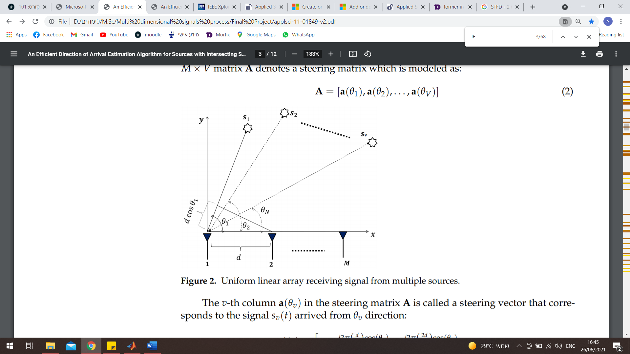

Problem Introduction
Problem set-up:
The signal model is given by: $x\left(t\right)=As\left(t\right)+w\left(t\right)=\sum_{v=1}^{V}{a\left(θ_{v}\right)s_{v}\left(t\right)+n\left(t\right)}$ where: $a\left(θ_{v}\right)={\left[1,e^{−j2π\left(\frac{d}{λ}\right)\cos\left(θ_{v}\right)},…,e^{−j2π\left(\frac{\left(M−1\right)d}{λ}\right)\cos\left(θ_{v}\right)}\right]}^{T}$
We want to use Time-Frequency (TF) method to estimate the angle of arrival (will be called DOA from now).

Slide 4
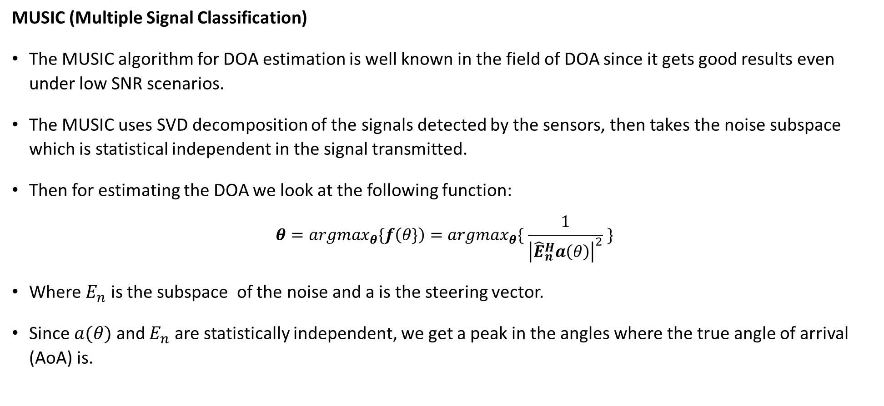
Related Work
MUSIC (Multiple Signal Classification)
The MUSIC algorithm for DOA estimation is well known in the field of DOA since it gets good results even under low SNR scenarios.
The MUSIC uses SVD decomposition of the signals detected by the sensors, then takes the noise subspace which is statistical independent in the signal transmitted.
Then for estimating the DOA we look at the following function:
$$θ=argmax_{θ}\{f\left(θ\}\right)=argmax_{θ}\{ \frac{1}{{\left|{\hat{E}}_{n}^{H}a\left(θ\right)\right|}^{2}} \}$$
Where $E_{n}$ is the subspace of the noise and a is the steering vector.
Since $a(θ)$ and $E_{n}$ are statistically independent, we get a peak in the angles where the true angle of arrival (AoA) is.

Slide 5
Related Work
Alternative methods
TF-MUSIC:
An enhancement of the MUSIC algorithm using Spatial Time-Frequency Distribution matrix (STFD), which is a variant of the known auto-correlation matrix.
SADTFD based on Viterbi DOA estimation:
The SADTFD solution first takes the STFD of the signal, then enhances the STFD with directional smoothing to an Adaptive directional TFD (ADTFD) and employs the Viterbi algorithm for IF estimation followed by source localization.
DOA based on IF estimation using ridge tracking:
First, in order to reduce complexity, the STFD calculated using only auto-terms.
In the next step the algorithm performs blind source separation using TF filtering at each sensor which is less complexed than the previously mentioned Viterbi algorithm.

Slide 6
Fast-IF Introduction
The Fast-IF (IF for instantaneous frequency) method comes in order to reduce complexity of previously presented algorithms while exploiting use of TF in order to also get better results.
While most MUSIC-based algorithms are only applicable for over-determined problems (e.g., number of sources < number of sensors), the Fast-IF method is applicable also for under-determined problems.
The purpose of the algorithm is to extract chirp components which can be intersecting in the TF domain, and then apply simple MUSIC algorithm on each component separately.

Slide 7
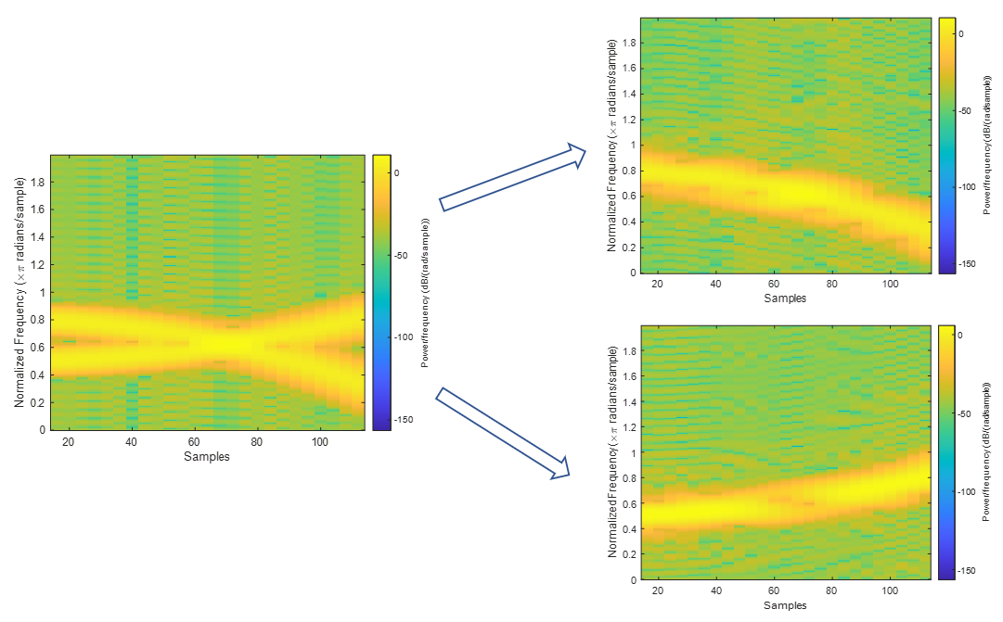
Fast-IF Introduction
Example for IF separation:

Slide 8
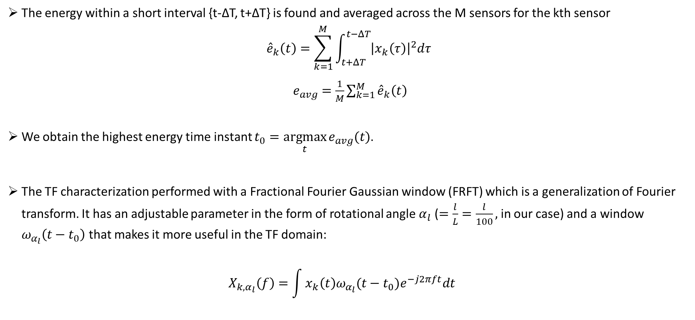
Fast-IF Algorithm
The energy within a short interval {t-∆T, t+∆T} is found and averaged across the M sensors for the kth sensor ${\hat{e}}_{k}\left(t\right)=\sum_{k=1}^{M}{\int_{t+ΔT}^{t−ΔT}{{\left|x_{k}\left(τ\right)\right|}^{2}dτ}}$
$e_{avg}=\frac{1}{M}\sum_{k=1}^{M}{{\hat{e}}_{k}\left(t\right)}$
We obtain the highest energy time instant $t_{0}=\underset{t}{argmax}{e_{avg}(t)}$.
The TF characterization performed with a Fractional Fourier Gaussian window (FRFT) which is a generalization of Fourier transform. It has an adjustable parameter in the form of rotational angle $α_{l}$ ($=\frac{l}{L}=\frac{l}{100},$in our case) and a window $ω_{α_{l}}\left(t−t_{0}\right)$ that makes it more useful in the TF domain: $X_{k,α_{l}}\left(f\right)=\int{x_{k}\left(t\right)ω_{α_{l}}(t−t_{0})e^{−j2πft}dt}$

Slide 9
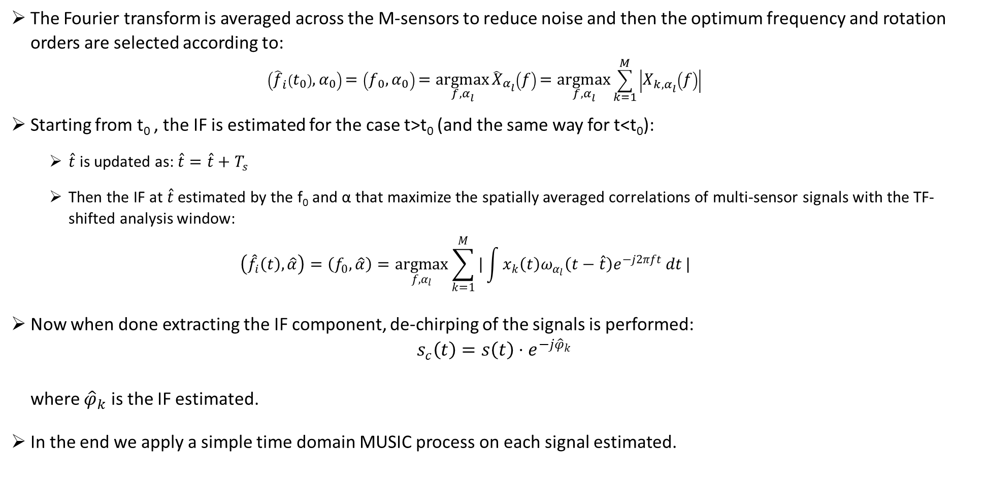
Fast-IF Algorithm
The Fourier transform is averaged across the M-sensors to reduce noise and then the optimum frequency and rotation orders are selected according to: $\left({\hat{f}}_{i}\left(t_{0}\right), α_{0}\right)=\left(f_{0}, α_{0}\right)=\underset{f, α_{l}}{argmax}{{\hat{X}}_{α_{l}}\left(f\right)=\underset{f, α_{l}}{argmax}{\sum_{k=1}^{M}{\left|X_{k,α_{l}}\left(f\right)\right|}}}$
Starting from t₀ , the IF is estimated for the case t>t₀ (and the same way for t<t₀):
$\hat{t}$ is updated as: $\hat{t}=\hat{t}+T_{s}$
Then the IF at $\hat{t}$ estimated by the f₀ and α that maximize the spatially averaged correlations of multi-sensor signals with the TF-shifted analysis window: $\left({\hat{f}}_{i}\left(t\right),\hat{α}\right)=\left(f_{0},\hat{α}\right)=\underset{f,α_{l}}{argmax}{\sum_{k=1}^{M}{|\int{x_{k}\left(t\right)ω_{α_{l}}\left(t−\hat{t}\right)e^{−j2πft}}dt}|}$
Now when done extracting the IF component, de-chirping of the signals is performed: $s_{c}\left(t\right)=s\left(t\right)⋅e^{−j{\hat{φ}}_{k}}$ where ${\hat{φ}}_{k}$ is the IF estimated.
In the end we apply a simple time domain MUSIC process on each signal estimated.

Slide 10
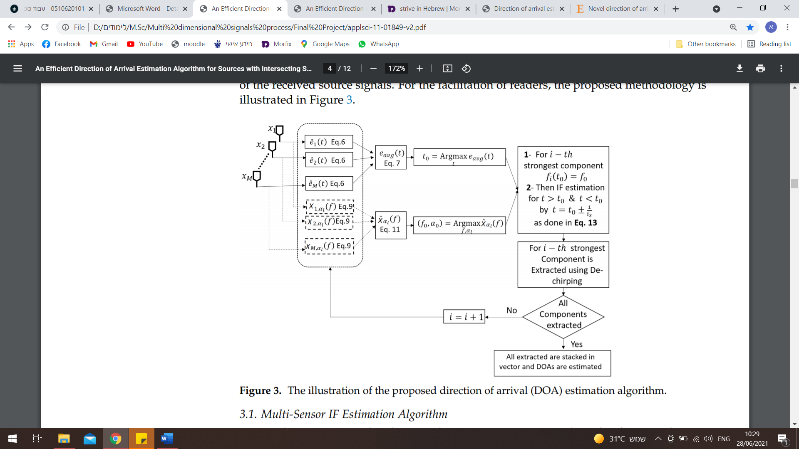
Fast-IF Algorithm
Illustration of the algorithm:

Slide 11
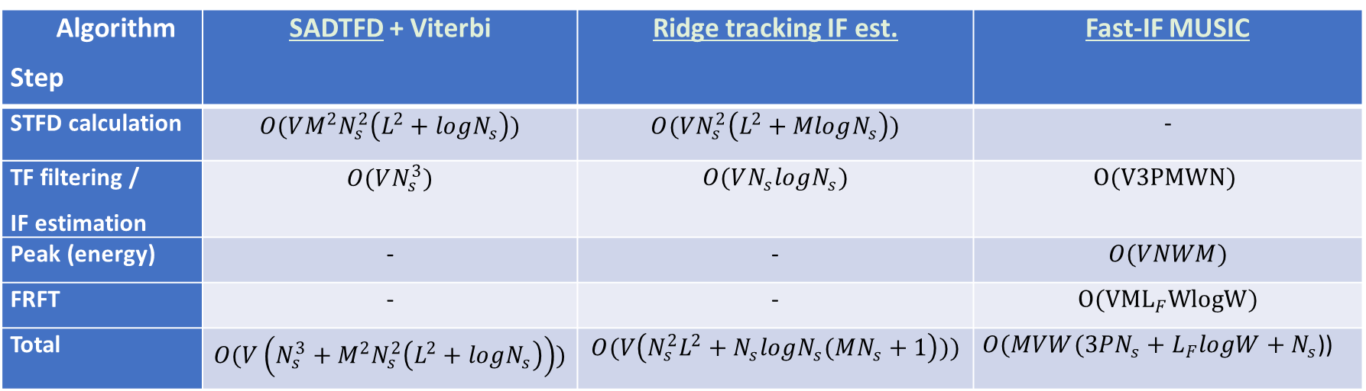
Computational Complexity
Below we see a brief table of complexity comparison:
Where:
W - computing FRFT at a single bin
P - number of bins searched over in every step
L_{F} - number of Fourier transform operations
V - total number of sources
M - number of sensors
Ns - number of samples in time domain
Algorithm Step | SADTFD + Viterbi | Ridge tracking IF est. | Fast-IF MUSIC
STFD calculation | $$O(VM^{2}N_{s}^{2}\left(L^{2}+logN_{s}\right))$$ | $$O(VN_{s}^{2}\left(L^{2}+MlogN_{s}\right))$$ | -
TF filtering / IF estimation | $$O(VN_{s}^{3})$$ | $$O(VN_{s}logN_{s})$$ | $$O(V3PMWN)$$
Peak (energy) | - | - | $$O(VNWM)$$
FRFT | - | - | $$O({VML}_{F}WlogW)$$
Total | $$O(V\left(N_{s}^{3}+M^{2}N_{s}^{2}\left(L^{2}+logN_{s}\right)\right))$$ | $$O(V\left(N_{s}^{2}L^{2}+N_{s}logN_{s}(MN_{s}+1\right)))$$ | $O(MVW(3PN_{s}+L_{F}logW+N_{s}$))

Slide 12

Computational Complexity
Below we see a brief table of complexity comparison:
An example (more details in full project book) for complexity calculation:
$SADTFD_{cost}=O(308x{10}^{6})$
${Ridge tracking}_{cost}=O(34x{10}^{6})$
${Fast−IF}_{cost}=O\left(7x{10}^{6}\right)$

Slide 13
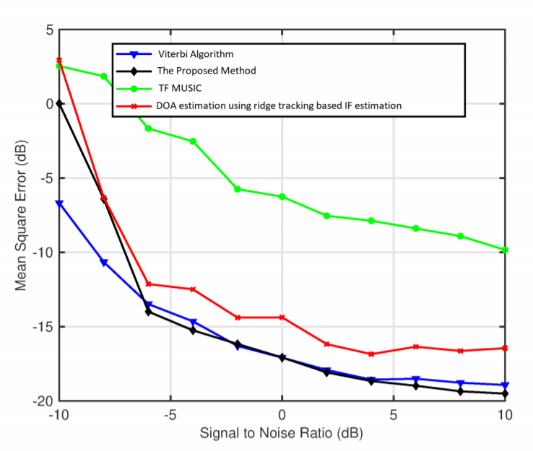
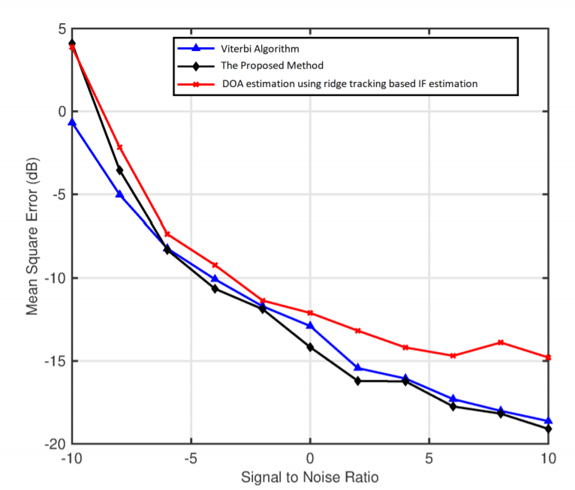
Further Results
Results presented in the article:
MSE for over-determined scenario
MSE for under-determined scenario

Slide 14
Further Results
Self tested results:
Gain differences effects:
Tested two sources in order to check sensitivity to gain differences:

Slide 15
Further Results
Self tested results:
Gain differences effects:
Tested two sources in different gains in order to check sensitivity to gain differences:
Non-Crossing Signals
Crossing Signals

Slide 16
Pros & Cons
The Fast-IF algorithm has a few advantages and disadvantages:
Pros:
Relatively efficient to other TF methods suggested.
Performs well for over and under determined problems (in comparison to TF-MUSIC algorithm).
Works for intersecting signals in TF-domain.
Does not assume any parametric assumption the modulation except for the fact it is FM modulation.
Cons:
The original algorithm assume knowledge of the number of sources.
When the signals has significant gains difference, we see a degradation in the performance.

Slide 17
Possible Improvement & Innovations
We suggest the following improvements based on the Fast-IF algorithm:
Detection capability – a simple algorithm was added to the original one in order to enable estimation without pre-knowledge about the number of sources.
2D estimation – another simulation were added showing an extension of DOA estimation to 2D estimation based on the 1D proposed estimation.

Slide 18
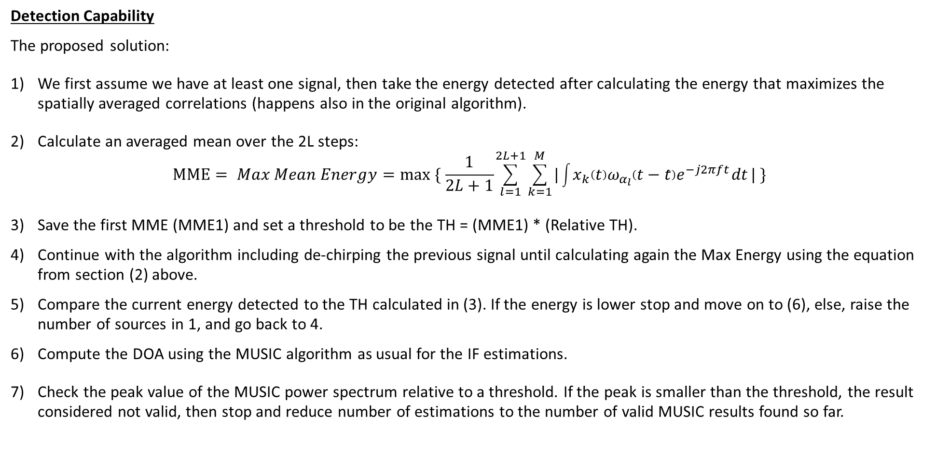
Possible Improvement & Innovations
Detection Capability
The proposed solution:
We first assume we have at least one signal, then take the energy detected after calculating the energy that maximizes the spatially averaged correlations (happens also in the original algorithm).
Calculate an averaged mean over the 2L steps: $MME= Max Mean Energy=max ⁡\{ \frac{1}{2L+1}\sum_{l=1}^{2L+1}{\sum_{k=1}^{M}{|\int{x_{k}\left(t\right)ω_{α_{l}}\left(t−\hat{t}\right)e^{−j2πft}}dt}|} \}$
Save the first MME (MME1) and set a threshold to be the TH = (MME1) * (Relative TH).
Continue with the algorithm including de-chirping the previous signal until calculating again the Max Energy using the equation from section (2) above.
Compare the current energy detected to the TH calculated in (3). If the energy is lower stop and move on to (6), else, raise the number of sources in 1, and go back to 4.
Compute the DOA using the MUSIC algorithm as usual for the IF estimations.
Check the peak value of the MUSIC power spectrum relative to a threshold. If the peak is smaller than the threshold, the result considered not valid, then stop and reduce number of estimations to the number of valid MUSIC results found so far.

Slide 19
Possible Improvement & Innovations
Detection Capability
Results of detection algorithm with threshold only in the TF domain:
(a) Scanning varying thresholds (b) Error Rate VS SNR for optimal threshold

Slide 20
Possible Improvement & Innovations
Detection Capability
Final results and proof of concept:

Slide 21
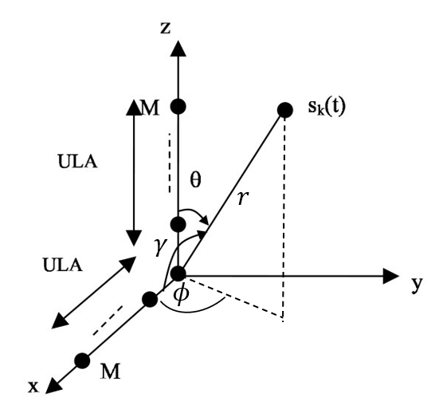
Possible Improvement & Innovations
2D DOA Estimation
We suggest an extension of 1D DOA estimation to 2D:
The problem set up:

Slide 22
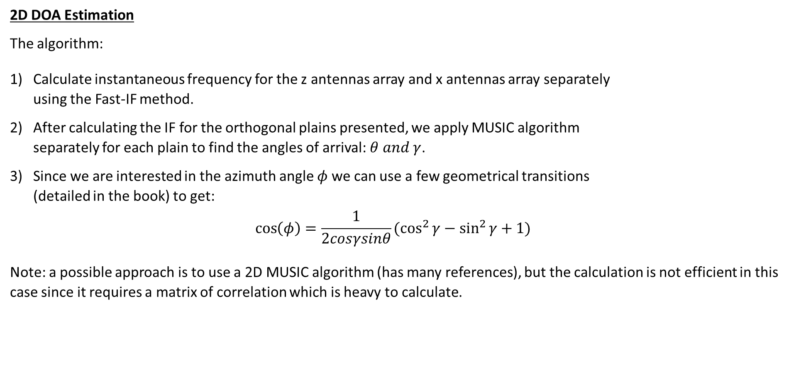
Possible Improvement & Innovations
2D DOA Estimation
The algorithm:
Calculate instantaneous frequency for the z antennas array and x antennas array separately using the Fast-IF method.
After calculating the IF for the orthogonal plains presented, we apply MUSIC algorithm separately for each plain to find the angles of arrival: $θ and γ$.
Since we are interested in the azimuth angle $φ$ we can use a few geometrical transitions (detailed in the book) to get: $\cos\left(φ\right)=\frac{1}{2cosγsinθ}(\cos^{2}{γ}−\sin^{2}{γ}+1)$
Note: a possible approach is to use a 2D MUSIC algorithm (has many references), but the calculation is not efficient in this case since it requires a matrix of correlation which is heavy to calculate.

Slide 23
Possible Improvement & Innovations
2D DOA Estimation
Proof of concept:
For one signal:

Slide 24
Possible Improvement & Innovations
2D DOA Estimation
Proof of concept:
For 3 signals:

